Slide 1
Introduction to Java

Slide 2
Introduction to Java
Java is an object-oriented language and is intended to let application developers write once, run anywhere (WORA), meaning that compiled Java code can run on all platforms that support Java without the need for recompilation.

Slide 3
A little history
Java was originally developed by James Gosling at Sun Microsystems and released in May 1995 as a core component of Sun Microsystems’ Java platform.
It was originally Called Oak
Java is now owned and managed by Oracle

Slide 4
The Virtual Machine
Java is both compiled and interpreted
Source code is compiled into Java bytecode
Which is then interpreted by the Java Virtual Machine (JVM)
Therefore bytecode is machine code for the JVM
Java bytecode can run on any JVM, on any platform
…including mobile phones and other hand-held devices

Slide 5
Architecture
.JAVA
Source file
.CLASS
Bytecode
Object Program
JDK
JVM

Slide 6
Platforms used by Java
Java Platform, Standard Edition (Java SE)
Java Platform, Enterprise Edition (Java EE) – For large scale applications
Java Platform, Micro Edition (Java ME) –For Small devices
Java FX – For internet applications

Slide 7
Platforms used by Java
All Java platforms consist of a Java Virtual Machine (VM) and an application programming interface (API).
The Java Virtual Machine is a program, for a particular hardware and software platform, that runs Java technology applications.
An API is a collection of software components that you can use to create other software components or applications.

Slide 8
Advantage of Java language
Portable
Stability
Code reusability
Secure due to information hiding
Platform Independence

Slide 9
Java Overview
Classes
Objects
Methods are functions that are defined inside a class to describe the behaviors of an object.
Attributes represent the state of an object.

Slide 10
Data Storage
Computer programs usually work with different types of data and need a way to store the values being used.
Programming languages use data types to differentiate the nature of data to store or use

Slide 11
Data types in Java
Java has two basic data types
Primitive types
Reference Types
Primitive types
integers, floating point numbers, characters, booleans, etc
Refer to actual values
Reference types
Arrays, Classes, Objects, etc
Refer to memory locations (by name, not location)

Slide 12
Primitive Types
Type | Description | Size
Boolean (boolean) | True/false value | 1 bit
Byte (byte) | Byte-length integer | 1 byte
Short (short) | Short integer | 2 bytes
Integer (int) | Integer | 4 bytes
Long (long) | Long Integer | 8 bytes
Float (float) | Single precision floating point number | 4 bytes
Double (double) | Double precision float | 8 bytes
Char (char) | Single character | 2 bytes

Slide 13
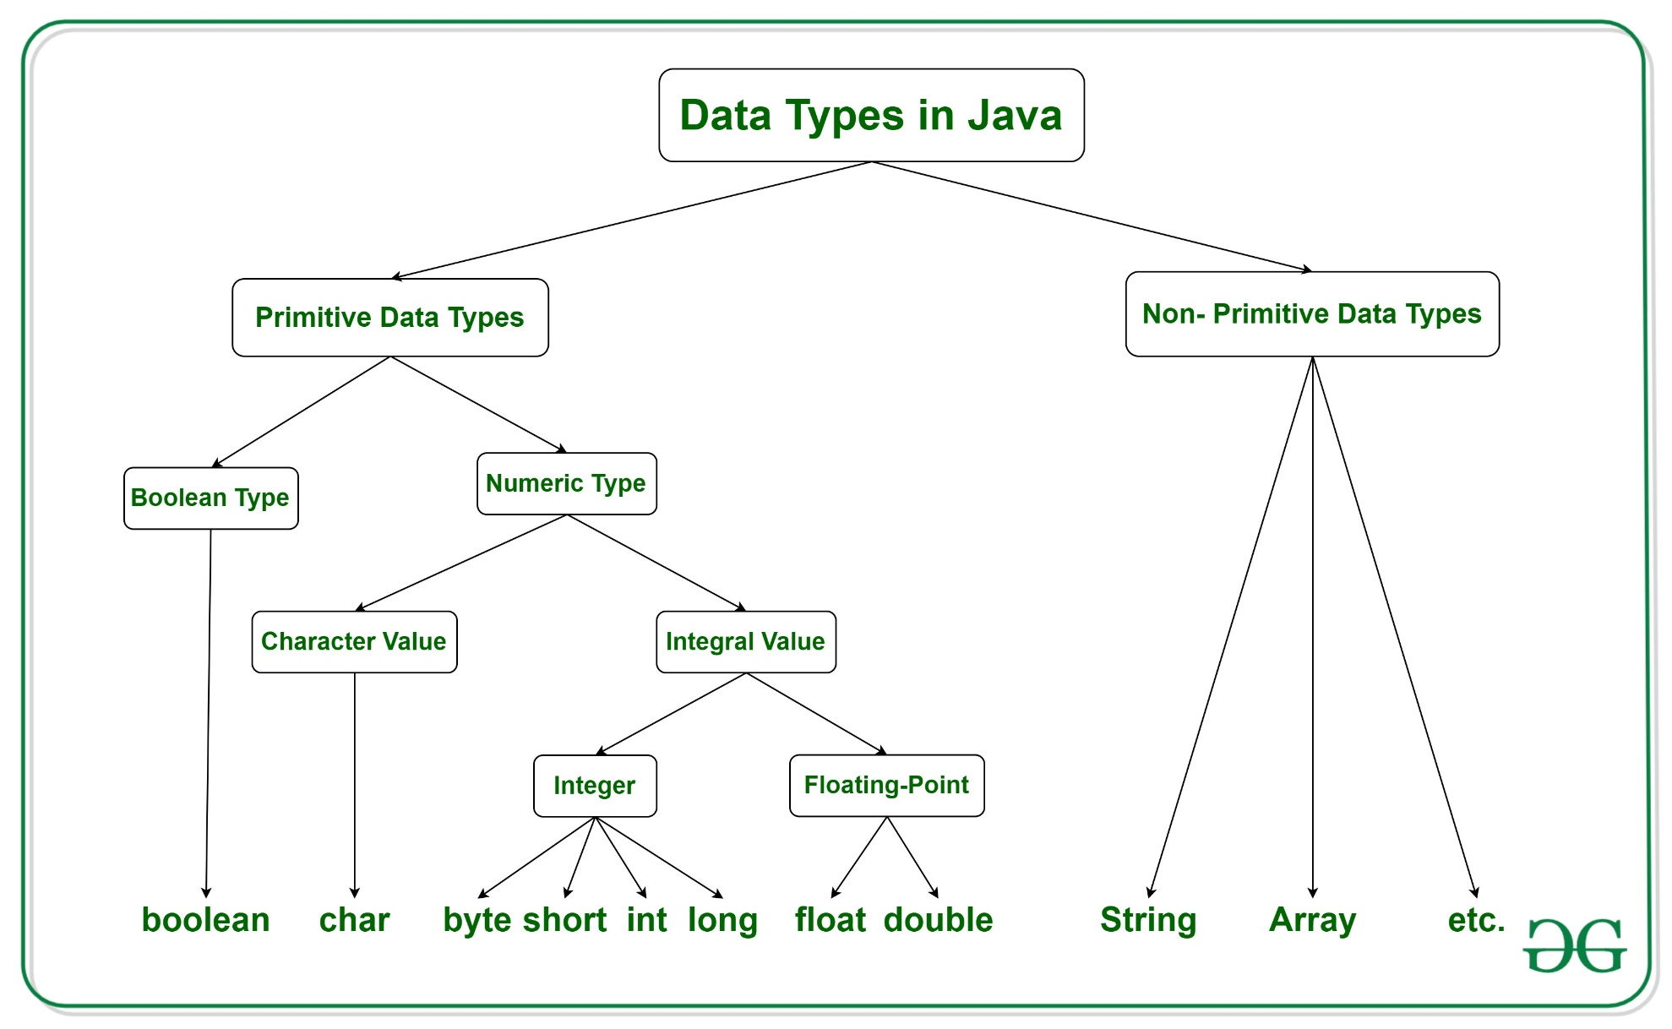
Data types

Slide 14
Variables in Java
All Java syntax is case sensitive
Valid Java names
Consist of letters, numbers, underscore, and dollar
Names can only start with letter or underscore
E.g. firstAttribute but not 1stAttribute
“Camel case” convention
Java encourages long, explanatory names
Start with a lower case letter, with words capitalised
E.g. thisIsCamelCase, andSoIsThisAsWell

Slide 15
Syntax Examples (Variables)
int anInteger;
boolean isSwitchOn;
Variables can be initialised when they are declared
int anInteger = 10;
boolean isSwitchOn = true;

Slide 16
Types of languages
Statically typed language where each variable and expression type is already known at compile time. Once a variable is declared to be of a certain data type, it cannot hold values of other data types. Example: C, C++, Java.
Dynamically typed languages. These languages can receive different data types over time. Example: Ruby, Python
Java is statically typed and also a strongly typed language because, each type of data (such as integer, character) is predefined as part of the programming language and all constants or variables defined for a given program must be described with one of the data types.

Slide 17
Types of Variables
Local Variables
Instance Variables
Static Variables

Slide 18
Local Variables
A variable defined within a block or method or constructor is called a local variable.
These variables are created when the block is entered, or the function is called and destroyed after exiting from the block or when the call returns from the function.
The scope of these variables exists only within the block in which the variable is declared. i.e., we can access these variables only within that block.
Initialization of the local variable is mandatory before using it in the defined scope.

Slide 19
Instance Variables
Instance variables are declared in a class outside any method, constructor, or block.
As instance variables are declared in a class, these variables are created when an object of the class is created and destroyed when the object is destroyed.
Unlike local variables, we may use access specifier for instance variables. If we do not specify any access specifier, then the default access specifier will be used.
Initialization of Instance Variable is not Mandatory. Its default value is 0
Instance Variable can be accessed only by creating objects.
int a

Slide 20
Static Variables
Static variables are also known as Class variables.
These variables are declared similarly as instance variables. The difference is that static variables are declared using the static keyword within a class outside any method constructor or block.
Unlike instance variables, we can only have one copy of a static variable per class irrespective of how many objects we create.
Static variables are created at the start of program execution and destroyed automatically when execution ends.
Initialization of Static Variable is not Mandatory. Its default value is 0
static int x;

Slide 21
SCOPE OF VARIABLE
Scope of a variable is the part of the program where the variable is accessible.
In Java, all identifiers are lexically (or statically) scoped, i.e. scope of a variable can be determined at compile time

Slide 22
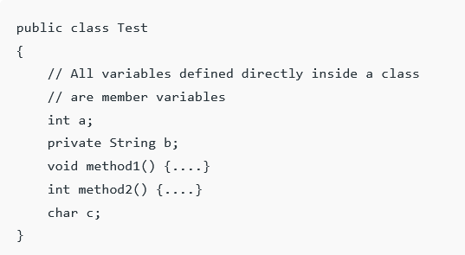
Member Variables (Class Level Scope)
These variables must be declared inside class (outside any method/function). They can be directly accessed anywhere in class.

Slide 23
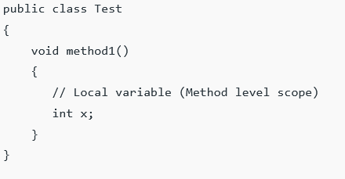
Local Variables (Method Level Scope)
Variables declared inside a method have method level scope and can’t be accessed outside the method. Local variables don’t exist after method’s execution is over.

Slide 24
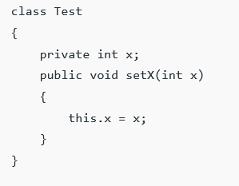
Local variables
Here’s another example of method scope, except this time the variable got passed in as a parameter to the method:
The code uses
this keyword to
differentiate between
the local and class
variables.

Slide 25
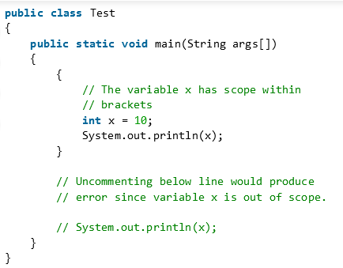
Loop Variables (Block Scope)
A variable declared inside pair of brackets “{” and “}” in a method has scope within the brackets only.

Slide 26
Some Important Points about Variable scope in Java
In general, a set of curly brackets { } defines a scope.
In Java we can usually access a variable as long as it was defined within the same set of brackets as the code we are writing or within any curly brackets inside of the curly brackets where the variable was defined.
Any variable defined in a class outside of any method can be used by all member methods.

